Slide 1
Mid-Semester Review
Group 400

Slide 2
Patient Tracker
Currently the University of Iowa Hospital Cardiology Department lacked an efficient way to track patient progress through various procedures
With Cardiologist Dr. Horwitz as our product owner we are developing a web-based solution using the Django web framework, Python, AWS, and Bootstrap
Features: Goal setting, analytics, patient alerts, and patient tracking

Slide 3
Milestones
Sprint 1 MVP: Login, Two-Factor, and implementation for basic workflow app.
Sprint 2 MVP: Navigation bar, index pages for patients and procedures, CRUD for patients and procedures, links to a patient/procedure profile where information can be edited.
Sprint 3 MVP: “Roadmaps” allow a user to follow a stream of procedures, CRUD operations for roadmaps, linking procedures and phases to a roadmap.

Slide 4
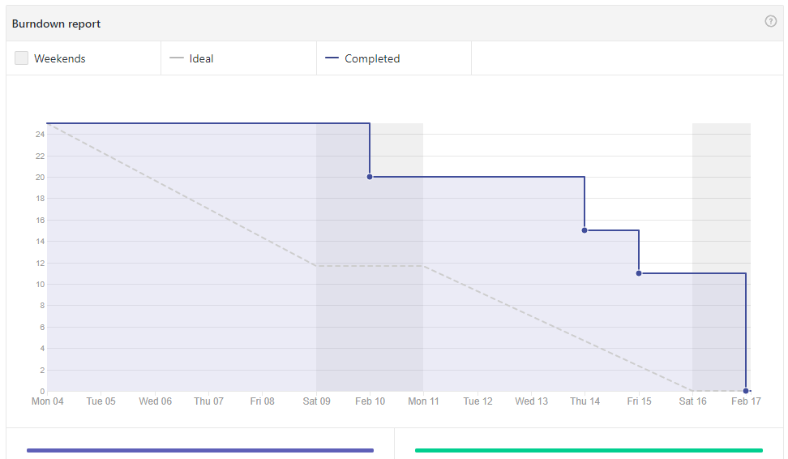
Sprint 1 Process
What went well:
Django base knowledge acquired by all team members in a fast and effective manner
92% code coverage
What needed to improve:
Pull requests response
better and more frequent SCRUMs/meeting minutes
integration testing
inconsistent burndown

Slide 5
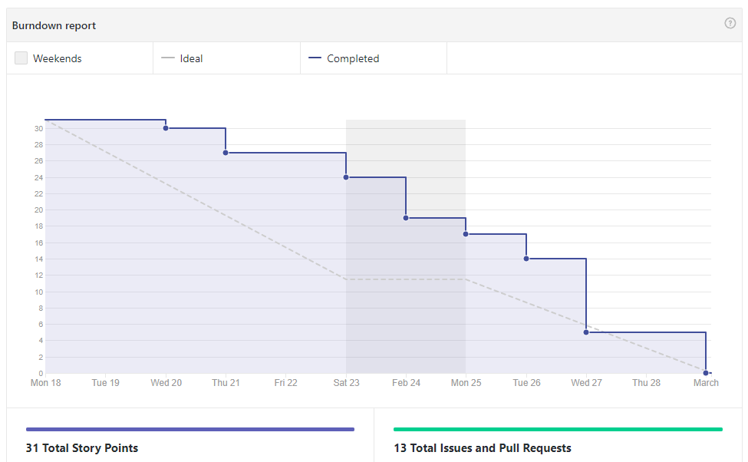
Sprint 2 Process
What Improved:
Discord for SCRUMs, 24 hours pull-request policy, burndown
What went well:
Scrums were held almost daily during the week
24-hour pull request policy succeeded in improving burndown
What needed to improve:
Issues not well defined, some team confusion and unexpected dependencies
BDD Proposed but not used, only implemented
AWS broke :(

Slide 6
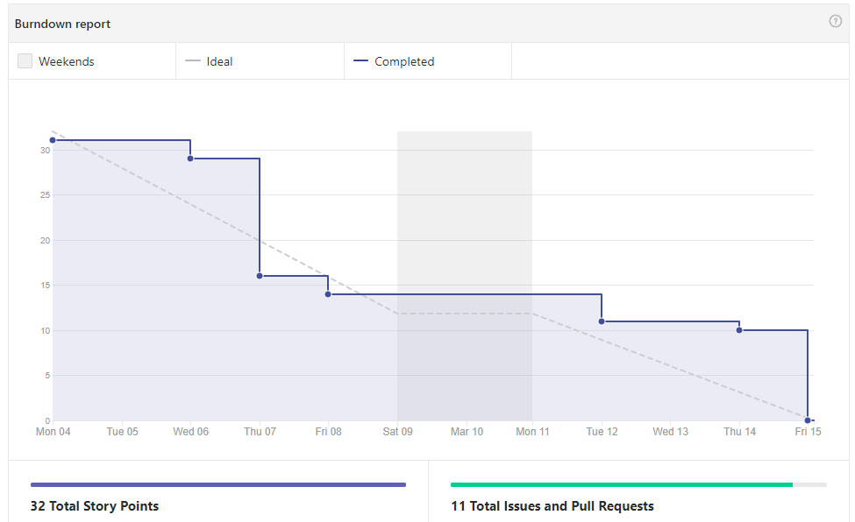
Sprint 3 Process
What improved:
Issues were slightly more well-defined, but story points were poorly estimated
What went well:
Important but subtle issues were resolved
What needed to improve:
Sprint planning needs to more effectively account for team schedules
AWS still broken :(

Slide 7
What has been going right...
We have had great participation in our discord meetings and they have increased our burndown and turnaround for pull requests.
We have been staying very close to our 24 hour pull request mark and it has cut down the time people spend in between stories.
Team members have been available to pair program when people need help.
Testing has been above the standard set at the beginning of the semester.
We have been able to minimize dependencies amongst stories.

Slide 8
What has been going wrong...
We need to refocus on BDD testing these last 3 sprints.
Our next product owner meeting will involve developing the desired scenarios for our application, so that it has maximum compliance with expectations and needs
User stories need to be fleshed out to minimize ambiguity.
From this point forward we will ensure we have a dedicated team meeting for story development, in order to eliminate distractions and ensure quality
Each issue will be reviewed as a team, and all members in attendance must agree the issue is satisfactory before the start of each sprint
Issue creation is our biggest process flaw, and putting an emphasis on creating quality issues for each sprint will greatly increase both our team and individual productivity
AWS :(

Slide 9
Future Sprints
Assign roadmaps/procedures to patients (Sprint 4)
Goal times on procedures (Sprint 4)
Analytics (Sprint 5)
User verification for deletion (sprint 5)
Fix AWS :( (tbd)
Adjustments in accordance to Dr. Horwitz’s requests (tbd)

Slide 10
Demo

